Slide 1
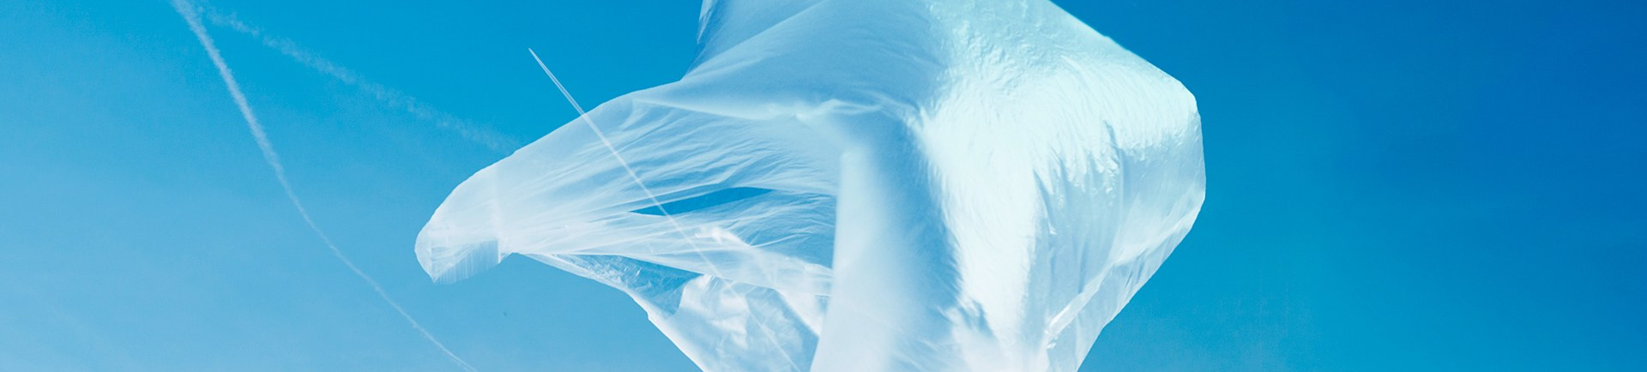
FANTASTIC PLASTIC
Exploring the History of Plastic : How it changed the world.

Slide 2
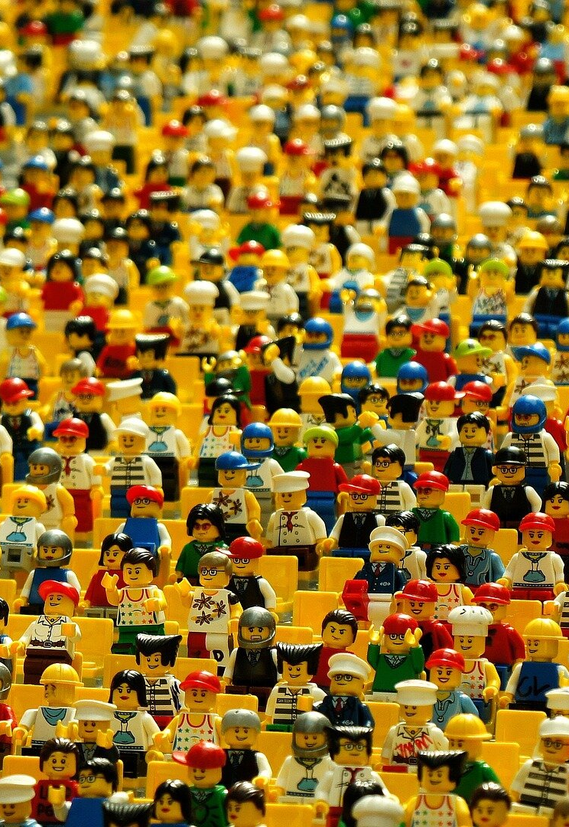
OUTLINE
INTRODUCTION
HYPOTHESES
DATA ANALYSIS
CONCLUSION
FUTURE STEPS
REFERENCES

Slide 3
INTRODUCTION
“We humans have become dependent on plastic for a range of uses, from packaging to products. Reducing our use of plastic bags is an easy place to start getting our addiction under control.”
Dr. David Suzuki, Canadian Academic & Environmental Activist 2012
Brief History
Plastic originally meant “pliable and easily shaped.”
The first polymer was invented in 1869 by John Wesley Hyatt.
The first synthetic polymer ‘Bakelite’ was invented by Leo Baekeland in 1907.
World War 2 caused the great expansion of the plastic industry.
In 1954, Dow Chemical invented expanded polystyrene used for building insulation, packaging, and cups.
In 1965, a Swedish Company (Cellopast) created and patented the “the T-Shirt Plastic Bag”

Slide 4
HYPOTHESES
Plastic multiple benefits and usage has been labelled as an environmental scourge. However it’s the lack of the knowledge and irresponsible use that caused the problem.
Data analysis will show commercial usage waste as the main culprit in plastic pollution.
Finding suitable plastic management is the solution rather than banning until a better alternative to plastic is invented.

Slide 5
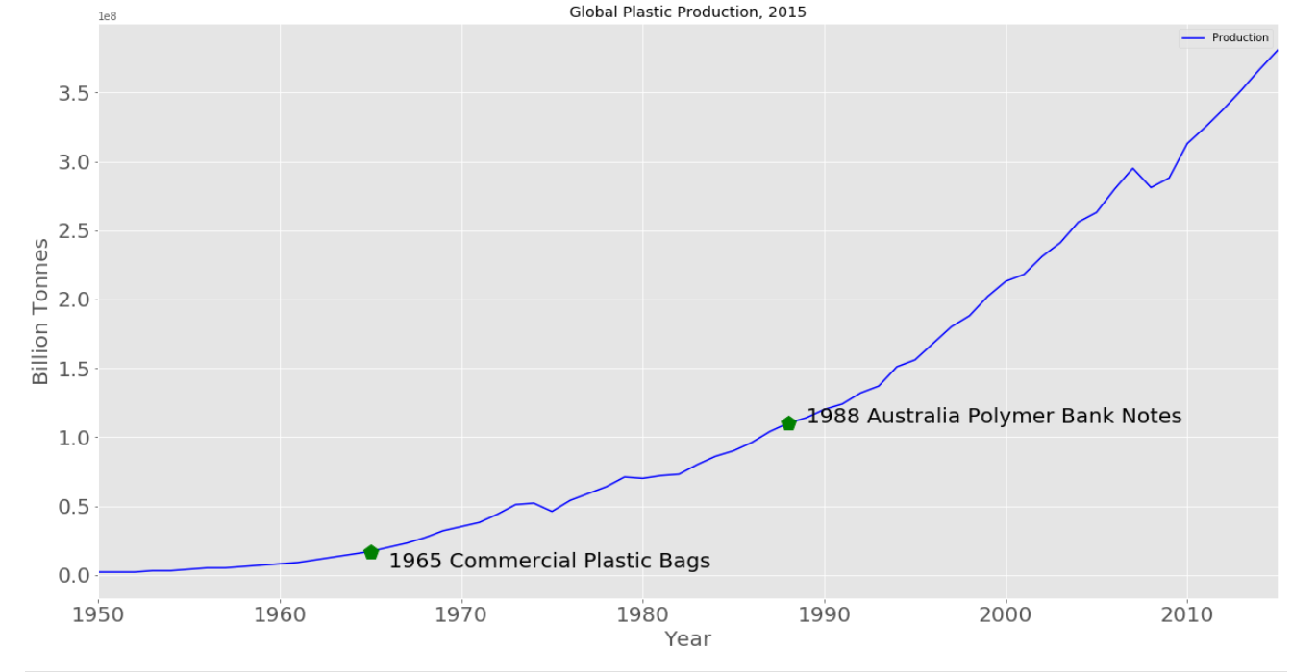
DATA ANALYSIS

Slide 6
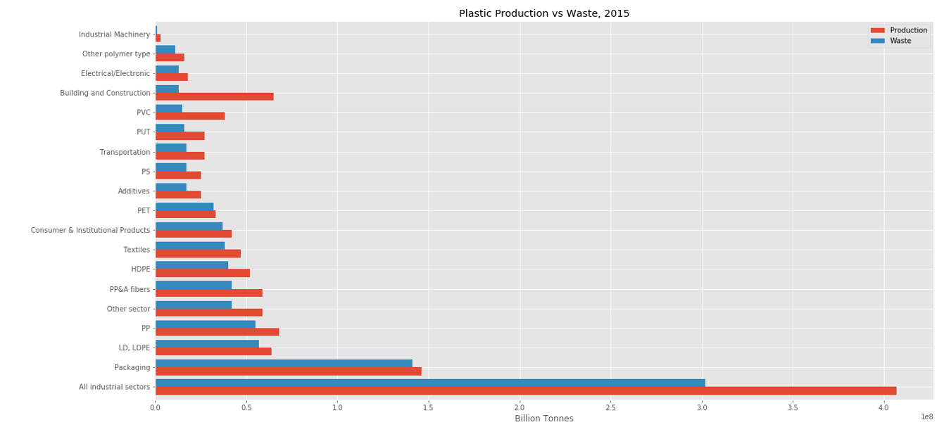
DATA ANALYSIS

Slide 7
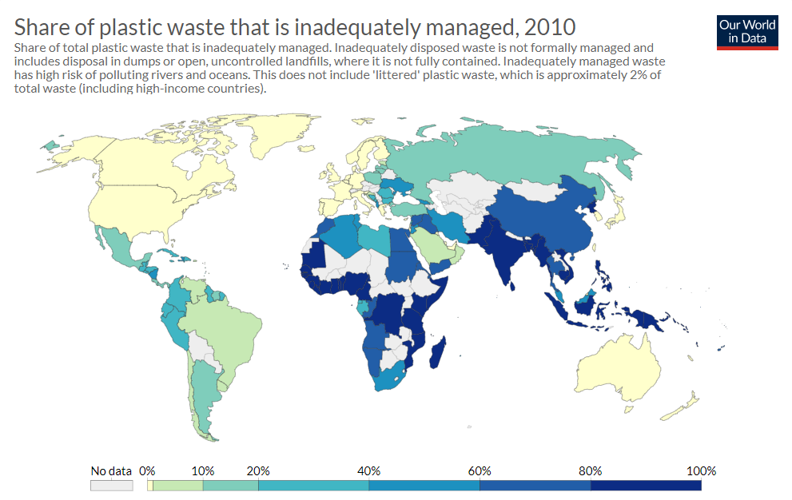

Slide 8
Conclusion
Plastic is not the environmental scourge. Its irresponsible usage.
Proper waste management and educate are the keys.

Slide 9
NEXT STEP
Data Analytics
- Finding countries and economies data.
- Research more on countries were carbon footprint is minimal.
Problems Encounter
- A lot of data floating around the internet. Contradicting figures. Broad topic need to be specific.
- Plotting world map.
- Need to learn internet data scraping
- Group datasets and creating a stack plot visualisation.

Slide 10
REFERENCES
https://www.sciencehistory.org/the-history-and-future-of-plastics
https://www.straight.com/news/david-suzuki-how-plastic-bags-are-hurting-environment
https://faberinfinite.com/plastic-is-not-the-problem-irresponsibility-is/
https://ourworldindata.org/plastic-pollution
Geyer, R., Jambeck, J. R., & Law, K. L. (2017). Production, use, and fate of all plastics ever made. Science Advances, 3(7), e1700782.
Jambeck, J. R., Geyer, R., Wilcox, C., Siegler, T. R., Perryman, M., Andrady, A., ... & Law, K. L. (2015). Plastic waste inputs from land into the ocean. Science, 347(6223), 768-771.

Slide 11

THANK YOU!
Antoni Angelo Alfon
GitHub Account:
https://github.com/anjojow
Email:
antoniangelo.alfon@gmail.com

